Slide 1
Machine Learning Project #2: MLP Classifier
Trevor Packan and Colin Partridge

Slide 2
Part 1: Preprocessing the Dataset
Dataset: Adult Census Income (26,048 records, 15 features)
Handle Missing Values:
Replaced '?' with NaN
Dropped rows with missing values
One-Hot Encoding: Categorical variables → 98 features
Train-Test Split: 70% train (18,233) / 30% test (7,815)
Standardization: StandardScaler applied to all features
Notes:
So we started with the Adult Census Income dataset. Because real-world data is rarely clean, we first replaced all “?” symbols with NaN values and used a mixed strategy of imputing the most common values for categorical columns like workclass and native-country while dropping other incomplete rows to maintain data integrity. Next, we applied one-hot encoding to transform categorical variables into numerical form, expanding the feature set to 98 columns — this was crucial since MLPs require purely numerical inputs. We verified that our training, test, and validation feature sets aligned perfectly, ensuring consistent column structures. We then performed a 70/30 train-test split, yielding 18,233 training samples and 7,815 testing samples, and standardized all features using StandardScaler so each variable had zero mean and unit variance. This scaling was key to preventing optimization bias and accelerating gradient convergence, giving us a stable foundation for model training.

Slide 3
Part 2: Implementing Multi-Layer Perceptron (MLP)
MLPClassifier from sklearn.neural_network
Hyperparameter Tuning using GridSearchCV:
Hidden layer sizes: (100,) and (50, 50)
Activation: ReLU
Solver: Adam optimizer
Regularization (alpha): 0.0001 and 0.01
Learning rate: 0.001
Best Model Parameters:
Hidden layers: (100,)
Alpha: 0.01
Max iterations: 1000
Notes:
For our model, we implemented the MLPClassifier from sklearn.neural_network and used GridSearchCV to systematically tune hyperparameters through 3-fold cross-validation. We tested architectures with one hidden layer of 100 neurons and two hidden layers of 50 neurons each, compared activation functions, adjusted the L2 regularization parameter (alpha) between 0.0001 and 0.01, and varied the learning rate. We used the Adam optimizer for its adaptive learning rate and momentum, training each configuration up to 1,000 iterations to guarantee convergence without premature stopping. The best-performing model, based on validation accuracy, used a single hidden layer of 100 neurons, ReLU activation, alpha = 0.01, and a learning rate of 0.001. Cross-validation ensured our results generalized well beyond a single dataset split, and we found that this configuration achieved an ideal balance between bias and variance. This approach showcased how parameter tuning and careful model validation are essential to optimizing performance while maintaining stability.

Slide 4
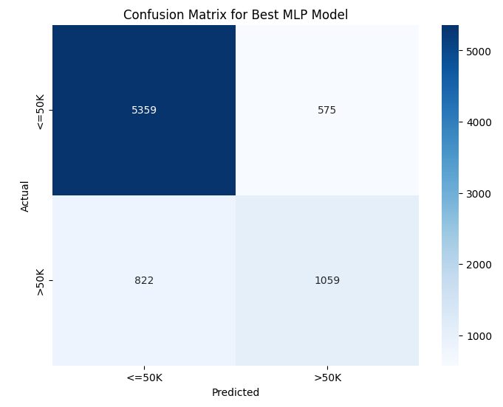
Part 3: Model Performance and Results
Test Accuracy: 82.12%
Classification Report:
≤50K: Precision=0.87, Recall=0.90, F1=0.88 (5,934 samples)
>50K: Precision=0.65, Recall=0.56, F1=0.60 (1,881 samples)
Weighted Averages:
Precision: 0.81 | Recall: 0.82 | F1-Score: 0.82
Confusion Matrix:
Strong performance on majority class (≤50K)
Lower recall for minority class (>50K)
Model shows slight bias toward majority class
Notes:
Our final model achieved an overall test accuracy of 82.12%. Looking at the classification report, the model performed strongly on the ≤50K class with a precision of 0.87 and recall of 0.90, meaning it correctly identified most lower-income individuals. However, its performance on the >50K class was weaker, with precision of 0.65 and recall of 0.56, showing difficulty capturing the minority class. This imbalance originates from the dataset’s structure, where most individuals earn below 50K, leading to slight bias in predictions. The confusion matrix confirms that the model favored the majority class, a common issue in unbalanced data. The weighted average precision, recall, and F1-score all remained around 0.82, indicating strong generalization with room for improvement. If we were to extend the project, we could use techniques like SMOTE oversampling or class-weight adjustments to better address the imbalance and improve minority class recall while maintaining interpretability and computational efficiency

Slide 5
Reflection: Architecture Choice
Why this architecture?
Simplicity & Interpretability: Easy to explain results for census income data
ReLU Activation: Faster training, reduces vanishing gradient problem
Hidden Layer Balance: 100 neurons provides enough capacity to capture patterns without overfitting
Optimal for Tabular Data: Structure suited for structured/census data
Regularization: Alpha parameter prevents overfitting
Adam Optimizer: Adaptive learning rates for efficient training
Notes:
So when we made our architecture, we focused on a single hidden layer provided enough complexity for any relationships between features and income and still avoiding the overfitting observed in deeper architectures. We initially tried a two-layer model of 50 neurons per layer, which slightly improved training accuracy but did not enhance test performance, so the single-layer model was the better choice. The ReLU activation function helped accelerate learning and prevented vanishing gradients, while L2 regularization (alpha = 0.01) controlled weight magnitudes to prevent overfitting. The Adam optimizer’s adaptive learning rates stabilized training across 1,000 iterations, and we monitored convergence to ensure smooth, non-divergent learning.

Slide 6
Reflection: Ethical Considerations
Key Concerns:
Bias & Fairness: Dataset contains sensitive features (sex, race, age) - risk of reproducing societal biases in employment/financial decisions
Privacy: Predictions based on personal demographic data could violate privacy if deployed beyond intended use
Transparency: Model decisions must be explainable to users
Notes:
Because the dataset has sensitive info such as sex, race, and age, training predictive models on this data raises several ethical concerns. Neural networks can unintentionally reproduce societal biases present in historical data — for instance, predicting lower income levels for groups that were historically underpaid. Features like marital status or occupation can act as proxies for protected characteristics, amplifying discrimination even if explicit sensitive variables are removed.

Slide 7
Reflection: Ethical Concerns
Mitigation Strategies:
Document model design and variable inclusion clearly
Audit predictions by demographic subgroups for bias
Build strong data governance policies
Ensure transparency in deployment contexts
Notes:
Because of these ethical concerns,,There are some strategies to use to stay fair and transparent. First, we state through our documentation and code comments of the model design and feature inclusion rationale so future users can see those potential bias sources. We could have occasionally audits of the model to detect and correct those disparities in prediction accuracy. If bias is detected, some retraining with balanced data or adjusting class weights would be necessary. We advocate for a strong data governance policy to make sure the data is being used for the right context when without human oversight.

Slide 8
Thank you

